Slide 1
A M E R I C A N
D E N T A L
E D U C A T I O N
A S S O C I A T I O N
2023–2024

Slide 2
TABLE OF CONTENTS
Revenue Sources & Expenditures of U.S. Dental Schools, 2021-22 Fiscal Year ..........................................................................................................................................................................................................1
Applicants
Timing of the Decision to Pursue a Career in Dentistry ..............................................................................................................................................................................................................................................2
Top Reasons for Choosing a Dental School ................................................................................................................................................................................................................................................................3
Diversity Among Predoctoral Dental Applicants .........................................................................................................................................................................................................................................................4
Predoctoral Dental Applicants & First-time, First-year Enrollees in U.S. Dental Schools ............................................................................................................................................................................................5
Students
First-year & Total Enrollments by Dental Education Program .....................................................................................................................................................................................................................................6
Diversity of First-time, First-year Enrollees ..................................................................................................................................................................................................................................................................7
Diversity of First-year Allied Dental Enrollees .............................................................................................................................................................................................................................................................8
Gender Distribution of First-year Predoctoral & Allied Dental Students.....................................................................................................................................................................................................................9
Student Sources of Funding for a Predoctoral Dental Degree .................................................................................................................................................................................................................................10
A Look at Education Debt .........................................................................................................................................................................................................................................................................................11
Predoctoral Dental Students' Immediate Professional Plans Upon Graduation .......................................................................................................................................................................................................12
Overview of Applications to and Enrollments in Accredited Advanced Dental Education Programs.......................................................................................................................................................................13
Applications to Accredited Advanced Dental Education ..........................................................................................................................................................................................................................................14
First-year Enrollment In Accredited Advanced Dental Education .............................................................................................................................................................................................................................15
Faculty
Dental School Faculty: Separations & New Hires ......................................................................................................................................................................................................................................................16
Women Faculty in Academic Dentistry .....................................................................................................................................................................................................................................................................17
Full-time and Part-time Faculty at U.S. Dental Schools by Age & Gender................................................................................................................................................................................................................18
Faculty at U.S. Allied Dental Programs by Age & Gender ........................................................................................................................................................................................................................................19
Diversity in Dental School Faculty .............................................................................................................................................................................................................................................................................20
Diversity in Allied Dental Education Program Faculty ...............................................................................................................................................................................................................................................21

Slide 3
REVENUE SOURCES & EXPENDITURES OF U.S. DENTAL SCHOOLS
2021–22 Fiscal Year
Student tuition and fees together with patient care service revenue generated almost two thirds of revenue for accredited
U.S. dental schools in 2021–22.
REVENUE SOURCES
Total revenue, 2021–22 Fiscal year = $4,438.1 million
TYPES OF EXPENDITURES
Total expenditures, 2021–22 Fiscal year = $3,983.3 million
Total of Other Revenue Sources
$473.8
Educational
$1,133.4
Research & Sponsored Training
$325.6
Total Other Expenditures
$507.7
Student Tuition & Fees
$1,987.6
Physical Plant
$238.4
11%
13%
7%
6%
9%
29%
9%
45%
University Indirect Support
$386.5
10%
9%
19%
26%
General University Overhead
$367.4
9%
State & Local Government
$440.9
Patient Care Services
$823.7
Research & Sponsored Training
$355.4
Dental School Administration
$351.1
Patient Care Services
$1,029.9
Notes: Percentages might not total to 100% due to rounding. “Total Other Revenue Sources” category includes continuing education revenue, auxiliary enterprises revenue, graduate medical education revenue, gift revenue, endowment earnings, financial aid revenue, federal educational revenue and other. “Total Other Expenditures” category includes the following functional categories: continuing education, financial aid expenses, computer services, library and learning resources, major capital expenditures, and other costs.
Source: ADEA analysis of American Dental Association, Health Policy Institute, 2021-22 Survey of Dental Education (Group III).
1

Slide 4
TIMING OF THE DECISION TO PURSUE A CAREER IN DENTISTRY
Almost half of the predoctoral senior students in the Class of 2023 who responded to the ADEA Survey of U.S. Dental School Seniors decided to become a dentist before going to college.
2023
Responses of 3,202 total students and 551 HURE students
Total HURE
2018
Responses of 3,914 total students and 478 HURE students
Total HURE
52%
47%
47%
44%
24%
22%
26%
24%
18%
18%
15%
15%
14% _{13%}
12%
10%
Before College
First/Second Years Third/Fourth Years After Graduating Undergraduates Undergraduates From College
Before College
First/Second Years Third/Fourth Years After Graduating Undergraduates Undergraduates From College
HURE includes the following four race and ethnicity categories: non-Hispanic African American, Hispanic or Latino of all races, non-Hispanic American Indian or Alaska Native and non-Hispanic Native Hawaiian or Other Pacific Islander. These four race and ethnicity categories are defined by the U.S. Department of Education for reporting data from higher education institutions. The HURE definition is based on the parity gap between the share among the U.S. population and the share among professionally active dentists for each of the race and ethnicity categories defined by the U.S. Department of Education for reporting data from higher education institutions.
Source: Istrate EC, Cooper BL, Singh P, Gül G, West KP. Dentists of Tomorrow 2023: An Analysis of the Results From the ADEA 2023 Survey of U.S. Dental School Seniors. American Dental Education Association (ADEA) Education Research Series. Issue 6, October 2023.
2

Slide 5
TOP REASONS FOR CHOOSING A DENTAL SCHOOL
Responses of 3,196 total students and 550 HURE students.
The top three reasons among all respondents for attending dental school were virtually
a tie.
For HURE respondents to the 2023 ADEA Survey of Dental School Seniors, finding a community
of students/faculty who are like the respondent and with whom they feel comfortable was the only reason included in the top five that was different from the
overall respondents.
Less expensive than other schools (e.g., due to in-state tuition, financial aid, etc.)
All Respondents
1
All Respondents
2
Proximity to family/friends
All Respondents
3
Academic reputation
All Respondents
4
The only school that offered me a place
Community of students/faculty who are like the respondent and whom they feel comfortable around
The culture at the school/program (e.g., size, social opportunities)
HURE Respondents
4
All Respondents
5
HURE Respondents
5
The only school that offered me a place
HURE includes the following four race and ethnicity categories: non-Hispanic African American, Hispanic or Latino of all races, non-Hispanic American Indian or Alaska Native and non-Hispanic Native Hawaiian or Other Pacific Islander. These four race and ethnicity categories are defined by the U.S. Department of Education for reporting data from higher education institutions. The HURE definition is based on the parity gap between the share among the U.S. population and the share among professionally active dentists for each of the race and ethnicity categories defined by the U.S. Department of Education for reporting data from higher education institutions.
Source: Istrate EC, Cooper BL, Singh P, Gül G, West KP. Dentists of tomorrow 2023: An analysis of the results of the ADEA 2023 survey of U.S. Dental School Seniors.J Dent Educ. 2023;1-14. https://doi.org/10.1002/jdd.13392
3

Slide 6
DIVERSITY AMONG PREDOCTORAL DENTAL APPLICANTS
HURE students expanded their representation among predoctoral applicants. In 2023, this group represented 19%
of applicants, an increase from
13% a decade earlier.
2023
Total: 11,198
Do not wish to report/unknown
2013
Total: 12,162
Do not wish to report/unknown
Nonresident Alien
2%
Two or more races (not Hispanic)
3%
Two or more races (not Hispanic)
Nonresident Alien
4%
4% _{6%}
7%
24%
Asian
24%
Asian
44%
American Indian/ Alaska Native
0.3%
50%
American Indian/ Alaska Native
0.2%
7%
5%
12%
8%
Black or African American
Black or African American
White
Native Hawaiian/ Other Pacific Islander
0.1%
Hispanic/Latino (any race)
Native Hawaiian/ Other Pacific Islander
0.1%
Hispanic/Latino (any race)
White
Notes: Applicants are individuals who applied for entry into a predoctoral program at one or more U.S. dental schools in a given year.
HURE includes the following four race and ethnicity categories: non-Hispanic African American. Hispanic or Latino of all races, non-Hispanic American Indian or Alaska Native and non-Hispanic Native Hawaiian or Other Pacific Islander. These four race and ethnicity categories are defined by the U.S. Department of Education for reporting data from higher education institutions. The HURE definition is based on the parity gap between the share among the U.S. population and the share among professionally active dentists for each of the race and ethnicity categories defined by the U.S. Department of Education for reporting data from higher education institutions.
Source: Singh P, Lawton KB, Istrate EC, Gul G, West KP. U.S. Dental School Applicants and Enrollees, 2023 Entering Class. Washington, DC: American Dental Education Association, January 2024.
4

Slide 7
PREDOCTORAL DENTAL APPLICANTS & FIRST-TIME, FIRST-YEAR ENROLLEES IN U.S. DENTAL SCHOOLS
First-time, first-year predoctoral enrollment continued to increase
in 2023, maintaining the rising trend of the past decade.
Five schools accepted their first class of predoctoral students between 2013 and 2023 and other existing schools increased their class sizes.
At the same time, the number of applicants to predoctoral programs fluctuated over the past decade; however, all below
the 2013 level. As a result, the ratio of applicants to first-time, first-year enrollees reached 1.71, the lowest level since 2013.
Applicants
First-time, First-year Enrollees
12,162
11,721
11,789
12,058
11,873
11,759
11,298
11,148
10,965
11,180
11,198
5,769
5,890
5,943
6,100
6,122
6,163
6,231
6,257
6,295
6,328
6,562
2013
2014
2015
2016
2017
2018
2019
2020
2021
2022
2023
5
Notes: Applicants are individuals who applied for entry into a predoctoral program at one or more U.S. dental schools in a given year. First-time, first-year enrollees are matriculated individuals for the first time at a U.S. dental school in a given year. ADEA calculates the “first-time, first-year enrollees” indicators based on an analysis of ADEA Associated American Dental Schools Application Service (ADEA AADSAS®) and Texas Medical & Dental Schools Application Service (TMDSAS) data.
Source: Singh P, Lawton KB, Istrate EC, Gul G, West KP. U.S. Dental School Applicants and Enrollees, 2023 Entering Class. Washington, DC: American Dental Education Association, January 2024.

Slide 8
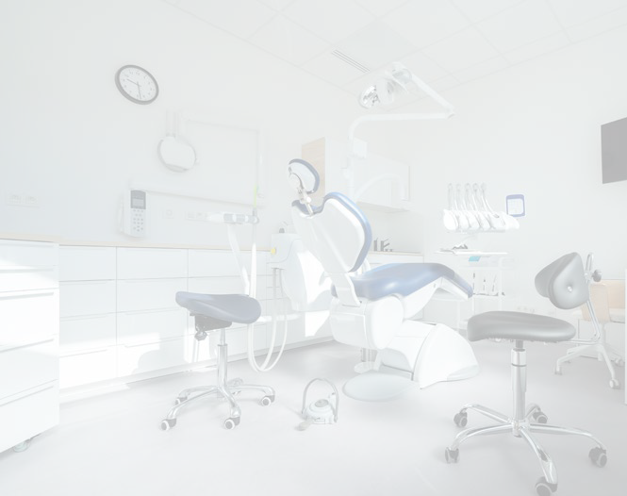
FIRST-YEAR & TOTAL ENROLLMENTS BY DENTAL EDUCATION PROGRAM
The overall enrollment in accredited dental education programs increased by 1% from five years before, driven by the rise in predoctoral enrollment.
The first-year enrollment mirrors this situation, with accredited predoctoral dental, advanced dental and dental hygiene recording rises from five years before and accredited dental assisting and dental laboratory technology programs witnessing plummeting rates.
While enrollment in accredited predoctoral dental, advanced dental and dental hygiene programs rose, accredited dental assisting and dental laboratory technology programs saw drops of 25% and 20%, respectively.
FIRST-YEAR ENROLLMENT BY DENTAL EDUCATION PROGRAM
2022–2023 2017–18
TOTAL ENROLLMENT BY DENTAL EDUCATION PROGRAM
2022–2023 2017–18
26,596
25,010
16,416
16,118
6,513
6,184
8,642
8,265
7,413
7,291
3,813
3,764
4,527
5,962
223
303
4,817
6,400
373
468
Predoctoral Dental Education
Advanced Dental Education
Dental Hygiene
Dental Assisting
Dental Laboratory Technology
Predoctoral Dental Education
Advanced Dental Education
Dental Hygiene
Dental Assisting
Dental Laboratory Technology
Notes: First-year enrollment for predoctoral students includes repeaters.The American Dental Association does not specify if the first-year enrollment in allied dental education programs and advanced dental education programs represents only first-time enrollees or includes repeaters. There were three CODA accredited dental therapy programs as of December 2023.
Notes: There were three CODA-accredited dental therapy programs as of December 2023.
6
Source: Analysis of American Dental Association, Health Policy Institute, Survey of Dental Education, Survey of Advanced Dental Education, Survey of Dental Hygiene Education Programs, Survey of Dental Assisting Education Programs, Survey of Dental Laboratory Technology Education Programs, 2022-23.

Slide 9
DIVERSITY OF FIRST-TIME, FIRST-YEAR ENROLLEES
HURE students represented 17% among first-time, first-year enrollees in 2023, an increase from 13% in 2013.
2023
Total: 6,562
Do not wish to report/unknown
2013
Total: 5,769
Do not wish to report/unknown
Nonresident Alien
2%
4%
Nonresident Alien
Two or more races (not Hispanic)
3%
Two or more races (not Hispanic)
5%
4% _{4%}
25%
Asian
23%
Asian
46%
American Indian/ Alaska Native
0.2%
53%
American Indian/ Alaska Native
0.2%
6%
5%
8%
Black or African American
11%
White
Black or African American
Hispanic/Latino (any race)
White
Native Hawaiian/ Other Pacific Islander
0.1%
Native Hawaiian/ Other Pacific Islander
0.1%
Hispanic/Latino (any race)
Notes: First-time, first-year enrollees are matriculated individuals for the first time at a U.S. dental school in a given year. ADEA calculates the “first-time, first-year enrollees” indicators based on an analysis of ADEA Associated American Dental Schools Application Service (ADEA AADSAS®) and Texas Medical & Dental Schools Application Service (TMDSAS) data. HURE includes the following four race and ethnicity categories: non-Hispanic African American. Hispanic or Latino of all races, non-Hispanic American Indian or Alaska Native and non-Hispanic Native Hawaiian or Other Pacific Islander. These four race and ethnicity categories are defined by the U.S. Department of Education for reporting data from higher education institutions. The HURE definition is based on the parity gap between the share among the U.S. population and the share among professionally active dentists for each of the race and ethnicity categories defined by the U.S. Department of Education for reporting data from higher education institutions.
Source: Singh P, Lawton KB, Istrate EC, Gul G, West KP. U.S. Dental School Applicants and Enrollees, 2023 Entering Class. Washington, DC: American Dental Education Association, January 2024.
7

Slide 10
DIVERSITY OF FIRST-YEAR ALLIED DENTAL ENROLLEES
Entering classes in accredited allied dental education have increasingly diversified.
Accredited allied dental programs expanded the most among Hispanic or Latino students, followed by Asian and multiracial students.
Over the same period, the share of white first-year allied dental enrollees tumbled
by more than 13 percentage points to 51%.
2022–23
Total: 13,392
2012–13
Total: 16,891
65%
51%
22%
0.8%
8%
9%
0.6%
3%
0.2%
0.8%
9%
12%
0.6%
2%
0.2%
5%
5%
6%
American Indian/Alaska Native
Hispanic/Latino (any race)
Two or more races (not Hispanic)
Asian
Native Hawaiian/Other Pacific Islander
Do not wish to report/unknown
Black or African American
White
Nonresident Alien
8
Notes: These figures reflect only the accredited allied dental programs in the specified year and with entering classes. Three dental therapy programs were accredited as of December 2023.
Source: Analysis of American Dental Association, Health Policy Institute, Surveys of Dental Hygiene Education Programs, Surveys of Dental Assisting Education Programs, Survey of Dental Laboratory Technology Education Programs, 2012-13 and 2022-23.

Slide 11
GENDER DISTRIBUTION OF FIRST-YEAR PREDOCTORAL & ALLIED DENTAL STUDENTS
The number of first-year enrollees in predoctoral programs who identified as women exceeded that of men in 2022–23, a trend that has continued since 2017-18.
Allied dental first-year enrollees remained overwhelmingly female over
the analyzed
period.
PREDOCTORAL DENTAL
Female Students Male Students Not Listed Gender Students
ALLIED DENTAL
Female Students Male Students Not Listed Gender Students
0.2%
2022–23
92%
2021–22
93%
2020–21
93%
2019–20
93%
0.4%
7%
0.3%
7%
0.3%
7%
0.3%
7%
2022–23
56% 43%
2021–22
56%
44%
2020–21
0.1%
54% 46%
2019–20
0.1%
53% 47%
2018–19
0.2%
2018–19
93%
51% 49%
7%
2017–18
2017–18
94%
50%
50%
6%
Notes: Percentages may not total 100% because of rounding. The American Dental Association (ADA) does not specify if the first-year enrollment in allied dental education programs represents only first-time enrollees or includes repeaters.
ADA First-year enrollment for predoctoral students by gender includes repeaters. ADA introduced an “Other” gender category for reporting of first-year enrollment by gender for predoctoral students in 2015-16 and for allied students in 2019-20. This category collects responses for those who prefer not to report gender, do not identify as either male or female, or whose gender is not available. ADEA calls this category “not listed” gender.
Source: ADEA Analysis of American Dental Association, Health Policy Institute, Surveys of Dental Education, Surveys of Dental Hygiene Education Programs, Surveys of Dental Assisting Education Programs, Survey of Dental Laboratory Technology Education Programs, 2017-18 to 2022-23.
9

Slide 12
STUDENT SOURCES OF FUNDING FOR A PREDOCTORAL DENTAL DEGREE
The senior predoctoral students of the Class of 2023 responding to the ADEA Senior Survey are funding their dental education with loans and using grants
and scholarships at about the same rate
as the Class
of 2018.
2023
2018
1%
0.4%
1% 1%
4%
3%
10%
10%
19%
20%
66%
65%
Loans
Savings From Self and/or Savings or Earned Income From Spouse
Financial Support From Parents, Relatives or Friends
Part-time Employment
Grants and/or Scholarships
Other
10
Notes: Percentages may add up to more than 100% due to rounding. The number of respondents to this question was 3,085 in 2023 and 4,003 in 2018.
Source: Istrate EC, Cooper BL, Singh P, Gül G, West KP. Dentists of tomorrow 2023: An analysis of the results of the ADEA 2023 survey of U.S. Dental School Seniors. J Dent Educ. 2023;1-14. https://doi.org/10.1002/jdd.13392

Slide 13
A LOOK AT EDUCATION DEBT
A higher percentage of predoctoral senior students responding to the ADEA Senior Survey graduated with debt in 2023 than five years before.
Average education debt of the indebted predoctoral senior students responding to
the ADEA Senior Survey was $296,500 in 2023.
ADEA SURVEY RESPONDENTS GRADUATING WITH DEBT
Percent of Respondents, 2018 and 2023
2023 2018
AVERAGE EDUCATION & AVERAGE DENTAL SCHOOL DEBT
Indebted ADEA Survey Respondents, 2018 to 2023, in Nominal Dollars
Average Education Debt Average Dental School Debt
Graduating with
Education Debt
$300
$297.0
$296.5
$293.0
$293.8
84%
$284.8
$281.7
80%
$284.2
$280.0
$280.1
$280.7
$300
Graduating with
Dental School Debt
$272.9
$270.1
82%
78%
$250
2018
2019
2020
2021
2022
2023
Notes: The number of respondents expecting to graduate with dental school debt was 2,518 in 2023 and 3,213 in 2018. The number of respondents expecting to graduate with education debt (dental school debt and /or predental education debt) was 2,591 in 2023 and 3,288 in 2018.
Notes: The response rates for this survey question vary between 37% in 2020 and 65% in 2018. A response rate reflects the number of respondents for the debt question relative to the senior student population in that academic year. Education debt is a combination of the dental school debt the senior students graduate with from dental school (the loans contracted to finance partially or all of the cost of the doctoral degree) and their predental education debt, which is the outstanding education debt the senior students had when they entered dental school. Debt values are nominal, as reported by the students in the specific survey year.
11
Source: Istrate EC, Cooper BL, Singh P, Gül G, West KP. Dentists of tomorrow 2023: An analysis of the results of the ADEA 2023 survey of U.S. Dental School Seniors. J Dent Educ. 2023;1-14. https://doi.org/10.1002/jdd.13392

Slide 14
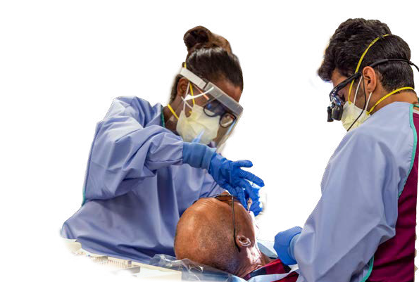
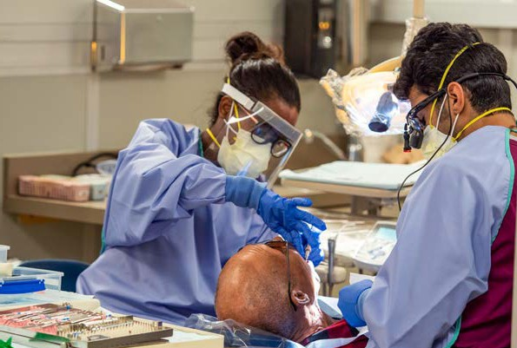
PREDOCTORAL DENTAL STUDENTS’ IMMEDIATE PROFESSIONAL PLANS UPON GRADUATION
The total number of respondents who provided information about their immediate plans after graduation is 3,048 total, (1,255 for men and 1,711 for women) in the 2023 ADEA Survey and 4,216 total (2, 111 for men and 2,014 for women) in the 2013 ADEA Survey.
Senior predoctoral students responding to the 2023 ADEA Senior Survey were more likely to join a private practice upon graduation than their 2013 counterparts.
Between 2013 and 2023, the share of survey respondents who expressed interest in working in a private practice immediately after graduation increased from 50% to 53%—
the most among professional plans.
2023
2013
2023
2013
2023
2013
53%
53%
55%
53%
50%
FEMALE RESPONDENTS
48%
MALE RESPONDENTS
ALL RESPONDENTS
36%
35%
35%
37%
36%
32%
11%
8%
2%
0.3%
0.4%
10%
3%
2%
0.5%
8%
3%
0.6%
0.3%
9%
3%
2%
0.4%
7%
1%
0.2%
0.2%
2%
1%
0.5%
Private Practice Dentist
Government Service or Nonprofit
Other
Advanced Education
Unsure
Teaching
Notes: Percentages may not total 100% because of rounding. The difference between the total number of respondents and the sum of men and women respondents is represented by senior students that identify with other genders or did not wish to report their gender identity. The “Other” category includes working in another position related to dentistry, but not those mentioned in the chart and working in a position not related to dentistry. The 2013 ADEA survey did not ask about plans to practice dentistry in a nonprofit setting; therefore the “government and nonprofit” counts for 2013 reflect only government professional plans. Photo courtesy of the University of Missouri-Kansas City School of Dentistry.
Source: American Dental Education Association U.S. Dental School Senior Student Surveys, 2013 and 2023.
12

Slide 15
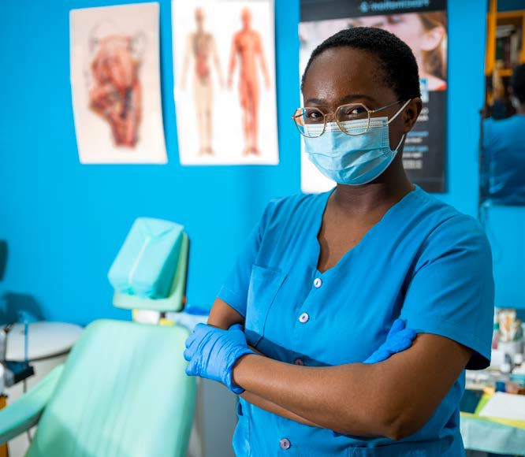
OVERVIEW OF APPLICATIONS TO AND ENROLLMENTS IN ACCREDITED ADVANCED DENTAL EDUCATION PROGRAMS
The number of applications
to accredited advanced dental education programs increased by almost half over the past decade. First-year matriculation and total enrollment
grew by 10–11%
over the period analyzed.
TOTAL APPLICATIONS
TOTAL FIRST-YEAR ENROLLMENT
TOTAL ENROLLMENT
TOTAL ACCREDITED PROGRAMS*
76,695
3,813
7,413
760
752
3,463
6,667
53,621
2022–23
2017–18
2022–23
2017–18
2022–23
2017–18
2022–23
2017–18
Notes: Application figures represent the total number of applications examined by all programs, and counts applicants more than once if they applied to multiple programs.
* The number of programs reflects the number of accredited advanced dental education programs in operation in the specified academic year. For 2022-23, it excludes accredited programs with non-enrollment status in 2022-23 and no 2022 graduates (n=10).
Source: ADEA analysis of American Dental Association, Health Policy Resources Center, Surveys of Advanced Dental Education 2012-13 and 2022-2023.
13

Slide 16
APPLICATIONS TO ACCREDITED ADVANCED DENTAL EDUCATION
More than half of the 15 disciplines of accredited advanced dental education programs added new programs and most of them received a significantly higher number
NUMBER OF PROGRAMS
APPLICATIONS
All General Dentistry*
290
296
99
102
68
66
83
77
55
55
56
55
47
46
22,924
16,292
Oral and Maxillofacial Surgery
Orthodontics & Dentofacial
Orthopedics
Pediatric Dentistry
15,839
10,251
12,899
9,709
10,293
9,681
Endodontics
3,178
7,289
TYPE OF PROGRAMS
Periodontics
4,259
of applications over the past decade.
2,062
Prosthodontics
Dental Public Health
2,562
1,928
Oral and Maxillofacial Radiology
Oral and Maxillofacial Pathology Clinical Fellowship in Oral And
Maxillofacial Surgery
Maxillofacial Prosthetics
Clinical Fellowship in Orthodontics
9 | 157
6 | 99
15 | 107
14 | 90
9 | 63
10 | 116
7 | 48
13 | 13
6 | 44
4 | 54
1
1
1
2
12
11
4
2022–23
Combined Orthodontics/Periodontics
Combined Prosthodontics/ Maxillofacial Prosthetics
2012–13
-
Notes: The number of programs reflects the number of accredited advanced dental education programs in operation in the specified academic year. For 2022-23, it excludes accredited programs with non-enrollment status in 2022-23 and no 2022 graduates (n=10). Application figures represent the total number of applications examined by all programs, and counts applicants more than once if they applied to multiple programs.
* All General Dentistry includes General Practice Residency, Advanced Education in General Dentistry, Dental Anesthesiology, Orofacial Pain, and Oral Medicine.
Source: ADEA analysis of American Dental Association, Health Policy Resources Center, Surveys of Advanced Dental Education 2012-13 and 2022-2023.
14

Slide 17
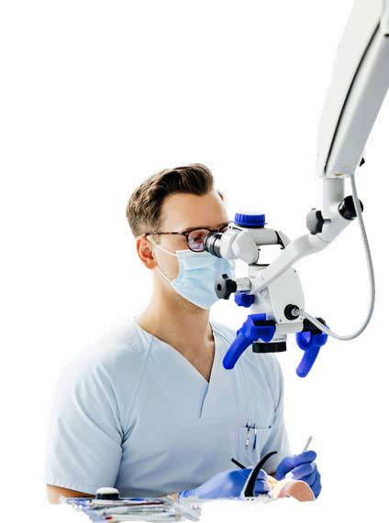
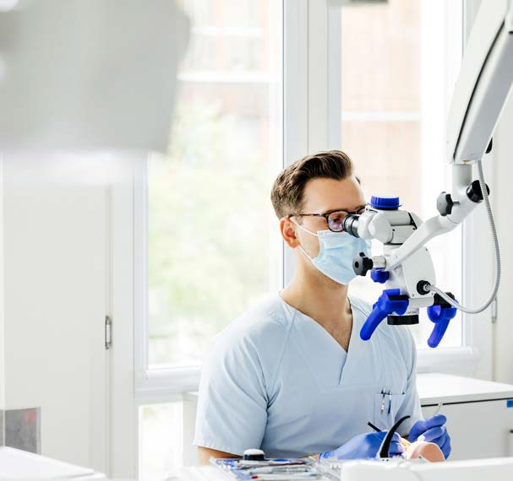
FIRST-YEAR ENROLLMENT IN ACCREDITED ADVANCED DENTAL EDUCATION
All the 15 advanced dental education program disciplines analyzed registered larger or similarly sized entering classes in 2022–23 relative
to 2012–13.
Program disciplines, such as oral and maxillofacial radiology, dental public health, and clinical fellowship in orthodontics, expanded their
first-year classes by more than 40% over the period analyzed.
FIRST-YEAR ENROLLMENT
TOTAL ENROLLMENT
All General Dentistry*
1966
1824
2324
2090
Oral and Maxillofacial Surgery
Orthodontics & Dentofacial
Orthopedics
Pediatric Dentistry
271
1255
249
1118
420
364
1140
991
486
405
984
823
Periodontics
187 |  |  | 581
182 |  |  | 550
221 |  |  | 475
211 |  |  | 455
TYPE OF PROGRAMS
Endodontics
Prosthodontics
158 |  | 467
148 |  | 463
24 13 |  | 52 41
33 |  | 52
22 |  | 46
17 |  | 46
17 |  | 52
Oral and Maxillofacial Radiology
Dental Public Health
Oral and Maxillofacial Pathology
Maxillofacial Prosthetics
Clinical Fellowship in Oral And
Maxillofacial Surgery
Clinical Fellowship in Orthodontics
13
13
9
9
7
5
1
1
0
0
13
13
11
12
7
5
4
4
2
4
2022–23
Combined Orthodontics/Periodontics
Combined Prosthodontics/ Maxillofacial Prosthetics
2012–13
Notes: The number of programs reflects the number of accredited advanced dental education programs in operation in the specified academic year. For 2022-23, it excludes accredited programs with non-enrollment status in 2022-23 and no 2022 graduates (n=10).
* All General Dentistry includes General Practice Residency, Advanced Education in General Dentistry, Dental Anesthesiology, Orofacial Pain, and Oral Medicine.
Source: ADEA analysis of American Dental Association, Health Policy Resources Center, Surveys of Advanced Dental Education 2012-13 and 2022-2023.
15

Slide 18
DENTAL SCHOOL FACULTY: SEPARATIONS & NEW HIRES
Leaving for a position at another dental school saw the highest growth as a source of faculty separations, followed by entering private practice.
When it comes to new dental school faculty, private practice or private sector employment remained the largest source.
REASONS FOR FACULTY SEPARATIONS
2021–22 2017–18
SOURCES OF NEW FULL-TIME & PART-TIME DENTAL FACULTY
2021–22 2017–18
1%
9%
7% 2%
_{3%} 3% 2%
4%
6%
3%
1%
2%
1%
0.4%
2%
9%
2%
17%
12%
_{17%} 29%
27%
5%
4%
11%
12%
13% 51%
17%
53%
19%
21%
17%
16%
Retired
Entered private practice
New from private practice/private sector employment
New postdoctoral/advanced degree graduate
New from a faculty position at a non-dental school
Other
After leaving armed services
New from a faculty position at another dental school
Other
Went to another dental school
New dental school graduate
New from a faculty position at a hospital
Returned from retirement
Finished fixed-term appointment
On leave
Went to a hospital/advanced dental education program
Deceased
16
Notes: Percentages may not total 100 due to rounding. This analysis reflects full-time and part-time faculty vacancies for which accredited dental schools reported the source of the new faculty member. Sixty-four schools provided this information to ADEA for the 2017-18 academic year and 61 did so for 2021-22.
Source: Source: American Dental Education Association, 2017-18 Survey of Dental School Faculty.

Slide 19
WOMEN FACULTY IN ACADEMIC DENTISTRY
Women are increasingly a larger proportion of faculty
in dental schools and accredited allied dental education programs. Faculty at accredited allied dental programs is majority women, increasing
10 percentage points since
2017–18.
U.S. ACCREDITED DENTAL SCHOOLS
U.S. ACCREDITED ALLIED DENTAL EDUCATION PROGRAMS
41%
2021–22
10%
2%
90%
0.1%
57%
Women
Men
Not Listed Gender
36%
20%
2017–18
2%
N/A
80%
62%
Notes: Percentages may not total 100% because of rounding. Dental school faculty includes faculty teaching predoctoral, allied dental and advanced dental education students at accredited U.S. dental schools who have full- or part-time status during the respective academic year. Therefore, there might be an overlap between the counts of dental school and allied dental education faculty. For 2021-22, the percentage of “not listed” gender for dental school faculty includes faculty who reported to their schools their gender as one of the following: transgender man, transgender woman, genderqueer/gender non-conforming, different gender identity or did not provide their gender identity. For 2017-18, the “not listed” gender reflects only the percentage of faculty who did not wish to report their gender identity to their employer. ADEA does not collect the data directly from the faculty members. Sixty-three dental schools provided ADEA data on their faculty gender information in 2017-18 and and 59 schools did so in 2021-22.
Source: Analysis of ADEA, 2017-2018 Dental School Faculty Survey and 2021-22 ADEA Faculty Census; American Dental Association, Health Policy Institute, 2017-2018 and 2021-22 Surveys of Dental Hygiene Education Programs, Dental Assisting Programs, and Dental Laboratory Technology Programs.
17

Slide 20
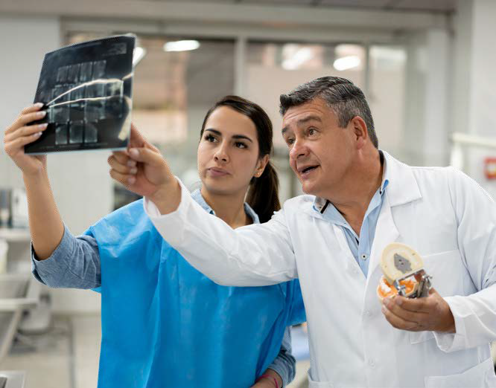
FULL-TIME AND PART-TIME FACULTY AT U.S. DENTAL SCHOOLS BY AGE & GENDER
2021–22
2017–18
The age distribution among men and women faculty remained relatively steady since 2017-18. The highest percentage of men faculty are age 60 or older (49%), and for women age
40 to 59 (50%).
Full-Time
21%
43%
22%
48%
53%
5%
1%
51%
2%
4%
11%
11%
21%
40%
25%
39%
20–39
Part-Time
29%
55%
30%
56%
40–59
2%
44%
2%
1%
46%
1%
25%
11%
23%
12%
60 and over
31%
31%
Age not reported
24%
49%
26%
52%
Total
4%
50%
4%
1%
49%
1%
11%
24%
12%
23%
36%
35%
Women
Men
Women
Men
Notes: Percentages may not total 100% because of rounding. For 2021-22, the percentage of “not listed” gender for dental school faculty includes faculty who reported to their schools their gender as one of the following: transgender man, transgender woman, genderqueer/gender non-conforming, different gender identity or did not provide their gender identity. For 2017-18, the “not listed” gender reflects only the percentage of faculty who did not wish to report their gender identity to their employer. Date of birth, which is used to calculate age, was a required field in 2017-18 and was optional in 2021-22. ADEA does not collect the data directly from the faculty members. Sixty-three dental schools provided ADEA data on their faculty gender and date of birth information in 2017-18 and 56 schools did so in 2021-22. Dental school faculty includes faculty teaching predoctoral, allied dental and advanced dental education students at accredited U.S. dental schools who have full- or part-time status during the respective academic year.
Source: American Dental Education Association, 2017-18 Survey of Dental School Faculty and 2021-22 ADEA Faculty Census
18

Slide 21
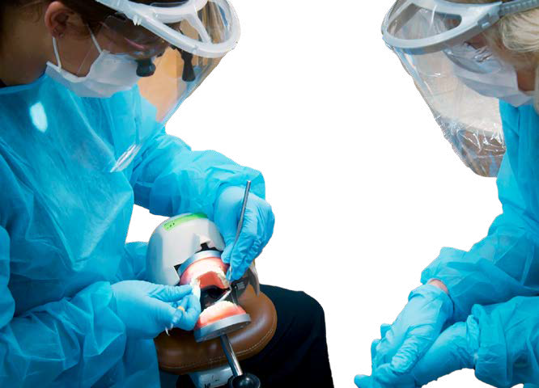
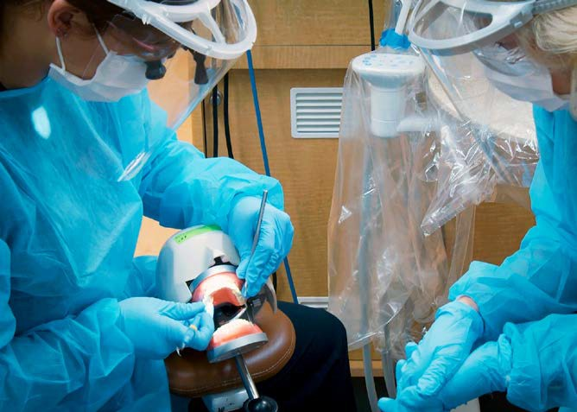
FACULTY AT U.S. ALLIED DENTAL EDUCATION PROGRAMS BY AGE & GENDER
2022–23
Women
Men
2017–18
Allied dental faculty saw larger numbers of young members coming into its fold.
The proportion of allied dental faculty younger than 40 years old recorded increases both among women and men. For women, it reached almost a third and for men it was close to one fifth.
31%
15%
20–39
27%
14%
20–39
Dental Hygiene
49%
31%
40–59
Dental Hygiene
52%
36%
40–59
19%
52%
60 and over
Age not reported
18%
49%
60 and over
Age not reported
2% 2%
6% 2%
28%
27%
27%
20–39
30%
9%
20–39
Dental Assisting
53%
Dental Assisting
52%
35%
40–59
40–59
17%
43%
60 and over
Age not reported
15%
49%
60 and over
Age not reported
1% 2%
2% 8%
Dental Laboratory Technology
31%
17%
20–39
Dental Laboratory Technology
31%
8%
20–39
43%
29%
40–59
60 and over
Age not reported
41%
36%
40–59
60 and over
Age not reported
6%
25%
5%
22%
20%
29%
23%
34%
All Allied Dental Education
30%
17%
20–39
All Allied Dental Education
28%
13%
20–39
50%
30%
40–59
52%
36%
40–59
18%
49%
60 and over
Age not reported
18%
47%
60 and over
Age not reported
2% 4%
3% 5%
Notes: Percentages may not total 100% because of rounding. This analysis does not report data on those who prefer not to report their gender, do not identify as either man or woman, or whose gender is not available because of the small count. Photo courtesy of the University of Louisville School of Dentistry.
Source: ADEA Analysis of American Dental Association, Health Policy Institute, Surveys of Dental Education, Surveys of Dental Hygiene Education Programs, Surveys of Dental Assisting Education Programs, Survey of Dental Laboratory Technology Education Programs, 2017-18 and 2022-23
19

Slide 22
DIVERSITY IN DENTAL SCHOOL FACULTY
The overall percentage of HURE faculty members in dental schools increased by three percentage points.
This increase was driven mainly by the rise in the representation of Hispanic or Latino faculty and, to a lesser extent, African American faculty. Overall, white faculty represented fewer U.S. dental school faculty in 2021–22 than in 2017–18.
2021–22
Overall percentage of HURE faculty: 13.6%
2017–18
Overall percentage of HURE faculty: 10.6%
Do not wish to report/unknown
Do not wish to report/unknown
Two or more races (not Hispanic)
0.7%
Nonresident Alien
Two or more races (not Hispanic)
0.4%
Nonresident Alien
12%
13%
5%
5%
Asian
American Indian/ Alaska Native
0.2%
Black or African American
Hispanic/Latino (any race)
10%
3%
7%
Asian
American Indian/ Alaska Native
0.3%
Black or African American
13%
56%
4%
9%
61%
Hispanic/Latino (any race)
Native Hawaiian/ Other Pacific Islander
0.3%
White
Native Hawaiian/ Other Pacific Islander
0.1%
White
Notes: Percentages may not total 100% because of rounding. Dental school faculty includes full- and part-time faculty at accredited dental schools in the United States. Historically Underrepresented Race and Ethnicity (HURE) faculty includes the following four race and ethnicity categories: non-Hispanic American Indian or Alaska Native, non-Hispanic African American, Hispanic or Latino of all races, and non-Hispanic Native Hawaiian or Other Pacific Islander. These four race and ethnicity categories are defined by the U.S. Department of Education for reporting data from higher education institutions. The HURE definition is based on the parity gap between the share of the U.S. population and the share of professionally active dentists for each of the race and ethnicity categories defined by the U.S. Department of Education for reporting data from higher education institutions. Dental schools report the race and ethnicity data for faculty members to ADEA, based on what the faculty provide them for the school’s administrative records.
ADEA does not collect the data directly from the faculty members. Only dental schools that reported race and ethnicity data for at least one faculty member are included in this analysis. Schools that reported “do not wish to report or unknown” for every faculty member are excluded from this analysis. Fifty-nine dental schools provided ADEA data on their faculty race and ethnicity information in 2017-18 and 52 schools did so in 2021-22, respectively.
Source: Analysis of American Dental Education Association (ADEA) Survey of U.S. Dental School Faculty, 2017-18 and ADEA Faculty Census, 2021-22.
20

Slide 23
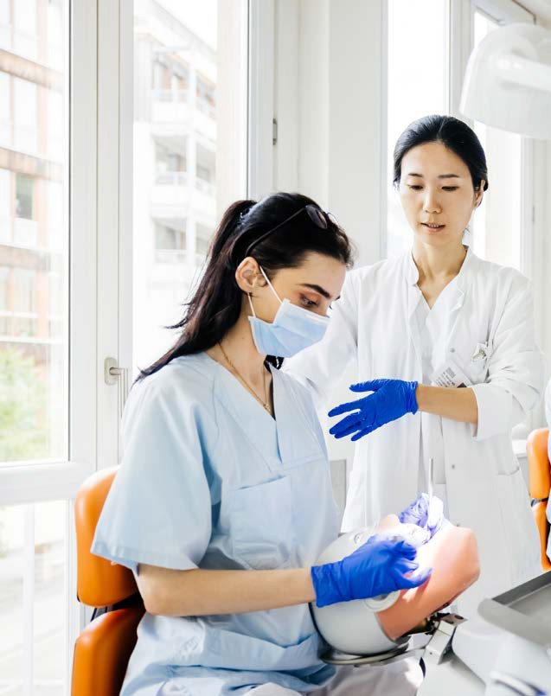
DIVERSITY IN ALLIED DENTAL EDUCATION PROGRAM FACULTY
Allied dental faculty remains overwhelmingly white, even though the proportion has been in slow decline over
the past five years.
2022–23
Full-time and Part-time HURE Faculty in Allied Dental Education Programs: 13%
2017–18
Full-time and Part-time HURE Faculty in Allied Dental Education Programs: 11%
79%
82%
0.3%
5%
5%
0.3%
1%
2%
0.1%
0.3%
3%
5%
0.3%
0.6%
3%
0.1%
7%
6%
American Indian/Alaska Native
Hispanic/Latino (any race)
Two or more races (not Hispanic)
Asian
Native Hawaiian/Other Pacific Islander
Unknown
Black or African American
White
Nonresident Alien
Notes: Percentages may not total 100% because of rounding.
HURE includes the following four race and ethnicity categories: non-Hispanic African American, Hispanic or Latino of all races, non-Hispanic American Indian or Alaska Native and non-Hispanic Native Hawaiian or Other Pacific Islander. These four race and ethnicity categories are defined by the U.S. Department of Education for reporting data from higher education institutions. The HURE definition is based on the parity gap between the share among the U.S. population and the share among professionally active dentists for each of the race and ethnicity categories defined by the U.S. Department of Education for reporting data from higher education institutions.
Source: ADEA Analysis of American Dental Association (ADA), Health Policy Institute, Surveys of Dental Hygiene Education Programs, Surveys of Dental Assisting Education Programs, Survey of Dental Laboratory Technology Education Programs, 2017- 18 and 2022-23.
21

